Slide 1

Decoding Salaries: A Machine Learning Dive into Naukri Job analysis

Slide 2

OBJECTIVE OF PROJECT:
This project aims to scrape and analyse job market data from Naukri to extract meaningful insights that can benefit job seekers and businesses. By examining trends in technology, required skills, salaries, and company classifications, the project aims to help aspirants understand the current job market landscape and prepare accordingly.

Slide 3
Dataset details
DATASET COLUMN | DESCRIPTION
COMPANY | Describes the different companies involved in the dataset.
EXPERIENCE | Describes the Experience ranges for corresponding companies, job titles, skills in that corresponding row.
JOB POST HISTORY | Describes how many days ago was the job posted on the Naukri website.
LOCATIONS | Describes the locations for the corresponding job that was posted.
RATINGS | Describes the Ratings of the companies that posted the jobs.
REVIEWS | Describes the Reviews given by the employees of the corresponding companies.
SALARY | Describes the Salary ranges for the corresponding job that was posted.
SKILLS | Describes the required skills to selected to the posted job.
TITLE | Describes the job title of the job role that was posted.

Slide 4
DATASET COLUMN | DESCRIPTION
Min_Experience | This column explain the division of the experience ranges column in which this column contains the minimum experience(eg: 5-8 is divided as min_exp=5, max_exp=8)
Max_Experience | This column explain the division of the experience ranges column which contains the maximum experience(eg: 5-8 is divided as min_exp=5, max_exp=8)
Job_post_days_ago | This column indicates the numeric part of the job_post_history column. The job_post history column in converted to numeric part(eg: 1 day ago I converted to 1)
Min_salary | This column explain the division of the Salary ranges column in which this column contains the minimum salary(eg: 5-8 is divided as min_salary=5, max_salary=8)
Max_salary | This column explain the division of the Salary ranges column in which this column contains the maximum salary(eg: 5-8 is divided as min_salary=5, max_salary=8)
Simulated _salary | This column simulates realistic salary ranges based on job title keywords like "senior" or "analyst", introducing a controlled, logic-based imputation strategy.
Salary class | This column Indicates the salary classes of the corresponding job that was posted the ranges are high, medium, low.
Industry | This column describes the different types industries of the companies(eg: IT, FINTECH, CONSULTING, GAMING)

Slide 5
OVERVIEW OF THE PROJECT/STEPS OF THE PROJECT
Exploration of the Dataset
Data loading
General info of the dataset
Data Cleaning
Summary Statistics of the dataset(1)
Exploratory Data Analysis(EDA)
Feature Extraction
Data Preprocessing the categorical and numerical columns
Company categorization according to its industries, size
Data Visualization
Summary statistics of the modified dataset(2)
Model Building:
Application of classification models on the dataset
Cross validation on the ML models
Hyperparameter tuning on ML models
Deployment:
Streamlit deployment

Slide 6
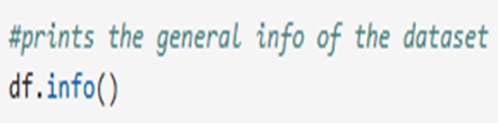
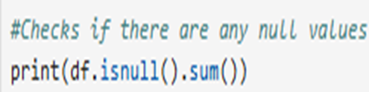
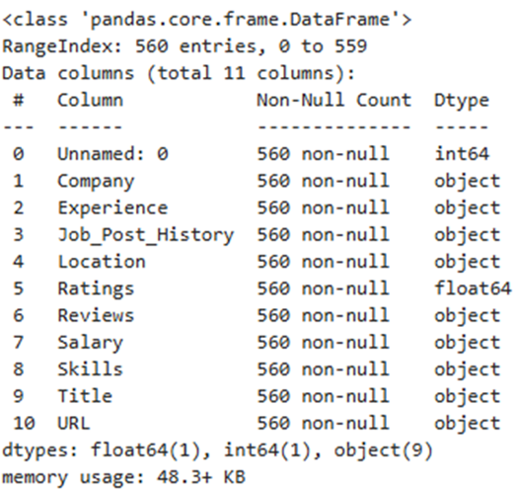
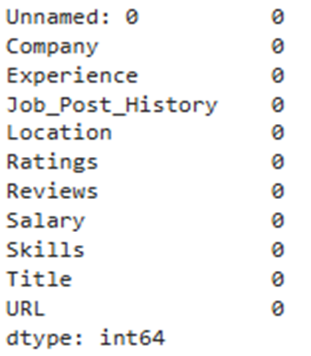
Exploration of dataset- Data loading, General info of the dataset
As part of the exploration of the dataset in finding the general info the dataset :
We have checked the null values present in the all columns of the dataset.
We have also checked the datatypes of the all columns in the dataset as indicates in the beside pictures the different datatypes present in the dataset are int64, float64, object.
Most frequently occurred datatype in the dataset is object.
We have also checked the shape of the dataset which indicate the number rows and columns.
Here we have done the data loading process as it is crucial step in moving forward in this project. As shown in the screenshot it shows the columns present in the dataset and sample part of the dataset.

Slide 7
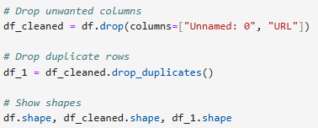

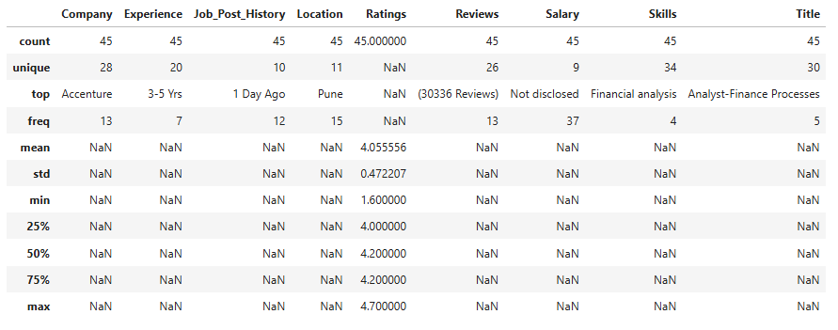

Exploration of dataset- Data cleaning, Summary statistics-1
Here are key insights from the dataset summary:
Accenture appears most frequently (13 times), and “3–5 Yrs” is the most common experience level. Most job posts were uploaded “1 Day Ago” and are located in Pune.
All 45 job entries have ratings, with an average of 4.06, ranging from 1.6 to 4.7, suggesting generally favorable company reviews.
Salary information is not disclosed in 37 out of 45 entries, indicating a major gap in compensation transparency.
There are 34 unique skills and 30 unique job titles, but only a few (e.g., "Financial analysis") are repeated, showing high role diversity.
As part of data cleaning process the insights obtained are:
We have dropped the “Unnamed:0, URL” columns from the dataset resulting in the shape of dataset to change from (560,11) to (560,9)
We have also dropped the duplicates of the dataset resulting in the shape of dataset to change to (560,9) to (45,9)

Slide 8
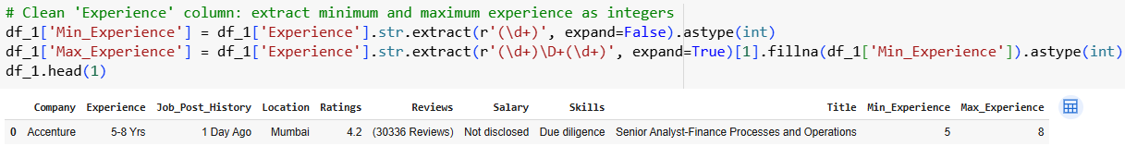
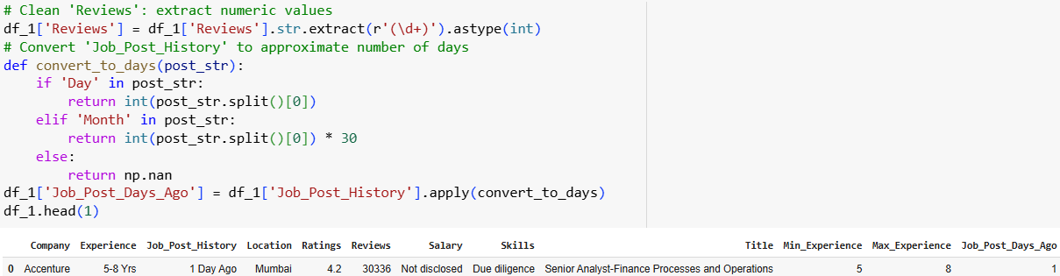
Exploratory Data Analysis(EDA) – Feature extraction- Experience, Reviews, Job post history
As part of the feature extraction process for experience, reviews, job post history columns:
The experience column is divided into two different columns called minimum and maximum experience by extracting the integer from the original experience ranges(object datatype)column
The reviews column is changed to numeric datatype from object datatype by extracting the numeric(integer) from the original column

Slide 9
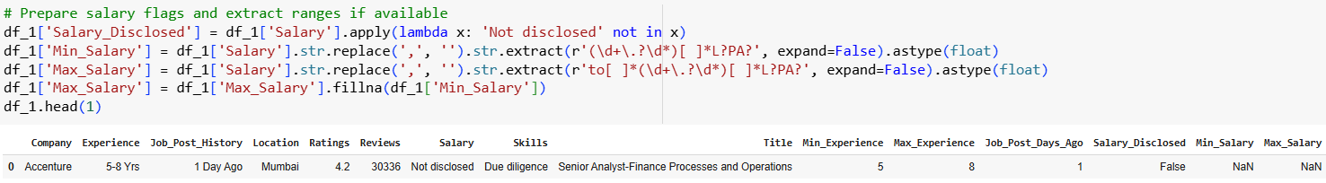
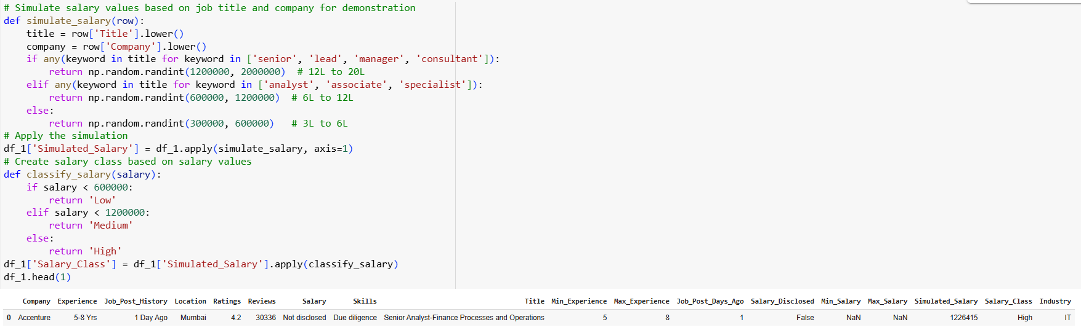
Exploratory Data Analysis(EDA) – Feature extraction- Salary column
As part of the feature extraction process for salary column here are 3 key insights from both screenshots:
Salary Extraction and Flagging: The code first identifies if salary is disclosed, then extracts Min_Salary and Max_Salary using regex patterns. If max salary is missing, it fills it with the min salary to ensure completeness.
Simulated Salary Estimation: For rows with undisclosed salaries, the code simulates realistic salary ranges based on job title keywords like "senior" or "analyst", introducing a controlled, logic-based imputation strategy.
Salary Classification: The simulated salaries are categorized into Low, Medium, and High classes based on predefined thresholds, enabling downstream tasks like classification modeling or salary distribution analysis.

Slide 10
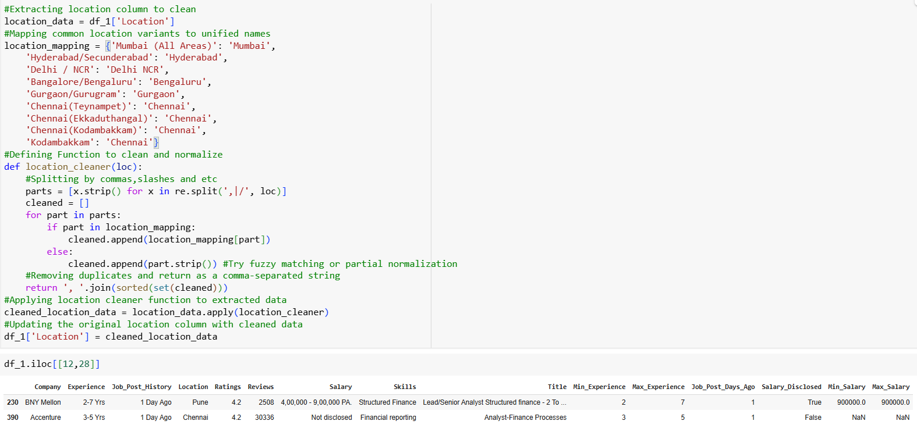
Exploratory Data Analysis(EDA)- Feature extraction- Location column
As part of the feature extraction process for locations column here are 4 insights based on the code and output shown:
Location Standardization: The code maps multiple location variants (like "Hyderabad/Secunderabad", "Chennai(Teynampet)", etc.) to standardized names (e.g., "Hyderabad", "Chennai") to ensure uniformity in the Location column.
Cleaning Logic: The location_cleaner function splits location strings by commas or slashes, maps known variants using location mapping, and removes duplicates for consistency.
Column Update: Cleaned location names are applied back to the original dataset using df_1['Location'] = cleaned_location_data, ensuring downstream processes work with cleaned values.
Data Preview: The preview (df_1.iloc[[12,28]]) confirms that standardized locations (like "Chennai") are now used, and also shows salary data being processed into separate Min_Salary and Max_Salary columns along with a Boolean Salary Disclosed flag.

Slide 11
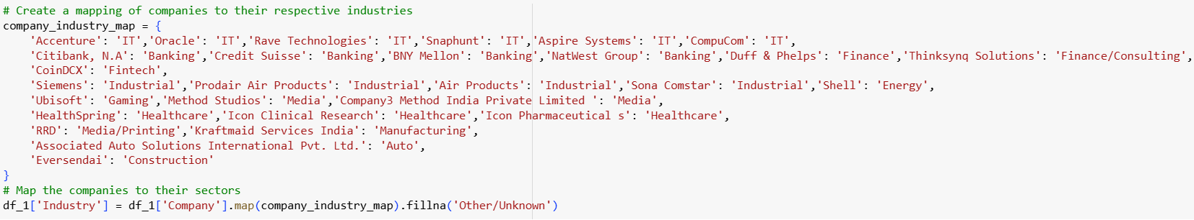
Exploratory Data Analysis(EDA)- Categorization of company- industry
As part of the Company categorization according to the industries
The industry column is created corresponding to the companies the industries included according to the companies columns are “IT, BANKING, FINANCE, FINANCE/CONSULTING, FINTECH, INDUSTRIAL, ENERGY, GAMING, MEDIA, HEALTHCARE, MEDIA/PRINTING, MANUFACTURING, AUTO and CONSTRUCTION”

Slide 12
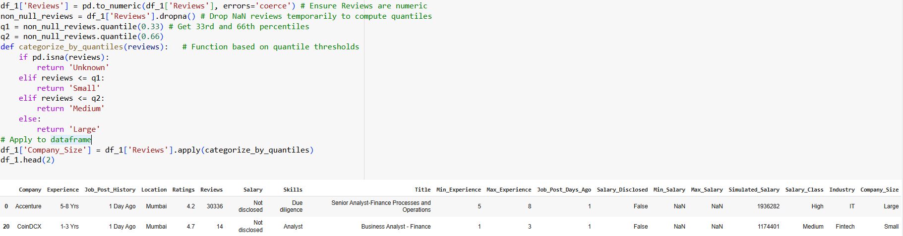
Exploratory Data Analysis(EDA)- Categorization of company- Size
Here are 4 insights based on the screenshot:
Companies are categorized by size based on the number of reviews:<120 = Small, 100–1200 = Medium, >1200 = Large.
Accenture and Oracle are classified as Large companies due to very high review counts (30,336 and 3,683 respectively), while CoinDCX is tagged as Small with only 14 reviews.
This classification approach helps to approximate company size from publicly available review data, useful when actual employee count is missing.
The logic includes a safeguard for missing values (NaN), assigning them the label "Unknown" to preserve data consistency.

Slide 13
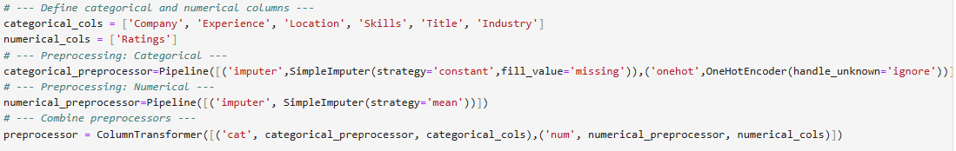
Exploratory Data Analysis(EDA)- Data preprocessing of categorical & numerical columns:
As part of the data preprocessing process for categorical and numerical columns here are insights from the preprocessing pipeline setup shown:
Categorical columns (Company, Experience, Location, Skills, Title, Industry) are preprocessed using a pipeline that applies:
Imputation with a constant value 'missing' for missing entries.
One-Hot Encoding, which converts categories into binary columns and safely handles unknown values during inference.
The numerical column (Ratings) is handled separately using a pipeline that fills missing values with the mean.
Both categorical and numerical pipelines are integrated using a Column Transformer, ensuring different types of columns are preprocessed appropriately within a unified pipeline.
This setup allows the transformed data to be seamlessly fed into machine learning models, maintaining modularity, scalability, and consistency across training and prediction phases.

Slide 14
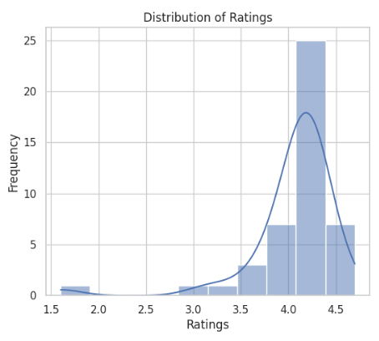
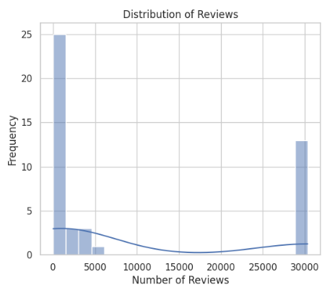
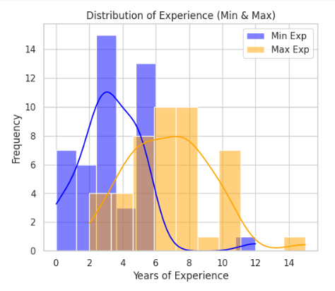
Data visualizations- histograms:
Ratings are skewed right with most values concentrated between 4.0 and 4.5, indicating generally positive feedback.
Reviews are highly right-skewed, with most companies having fewer than 5,000 reviews, while a few outliers exceed 25,000, indicating major differences in company visibility or popularity.
Minimum Experience mostly ranges from 2 to 6 years, while Maximum Experience is spread out wider, often between 4 to 10 years.

Slide 15
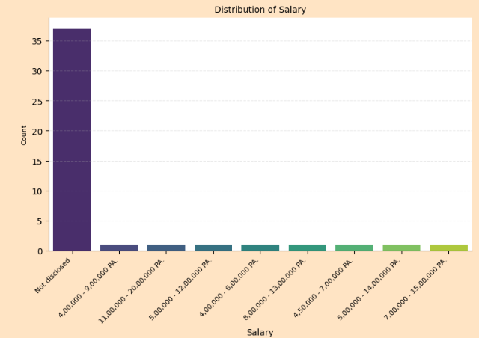
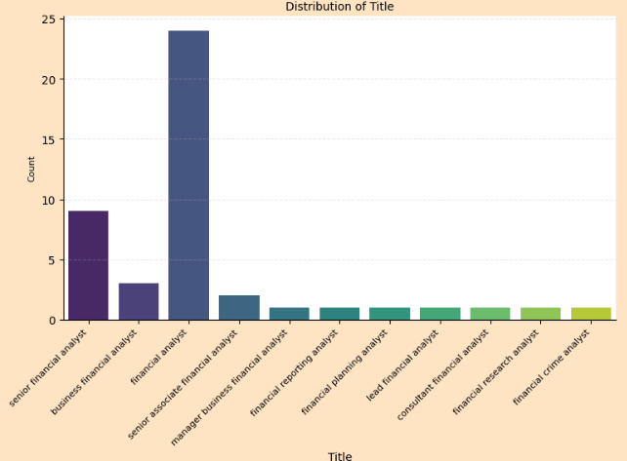
Data visualizations:
A large majority of job listings (over 80%) do not disclose salary, indicating limited transparency in compensation.
Among disclosed ranges, salaries between 4L to 9L PA appear most frequently.
The most common job title is “Financial Analyst”, which significantly outnumbers other roles.
Titles with the prefix “Senior” or “Manager” are relatively fewer, suggesting more openings for entry to mid-level roles.

Slide 16
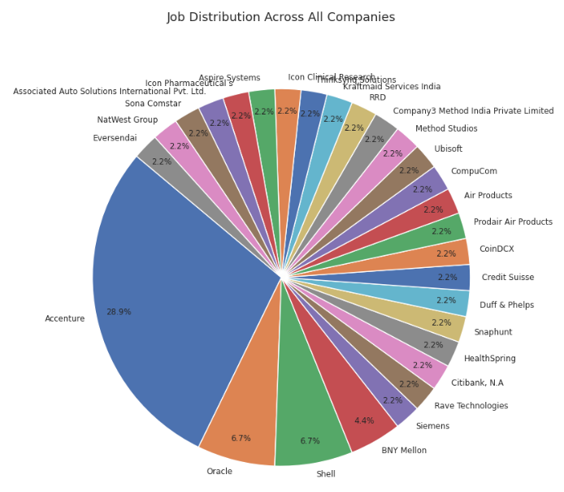
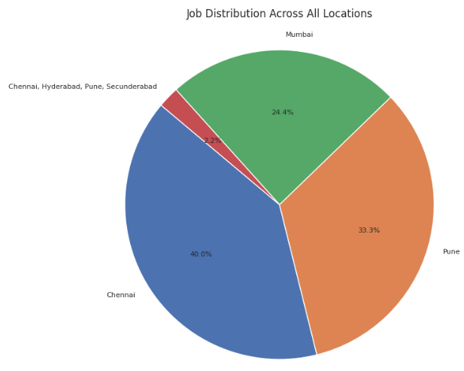
Data visualizations:
Accenture alone accounts for nearly 29% of all job postings, dominating the company-wise distribution.
Most other companies have a uniform share of about 2.2% each, indicating a fragmented distribution after the top few.
In terms of locations, Chennai leads with 40% of job postings, followed by Pune (33.3%) and Mumbai (24.4%).

Slide 17
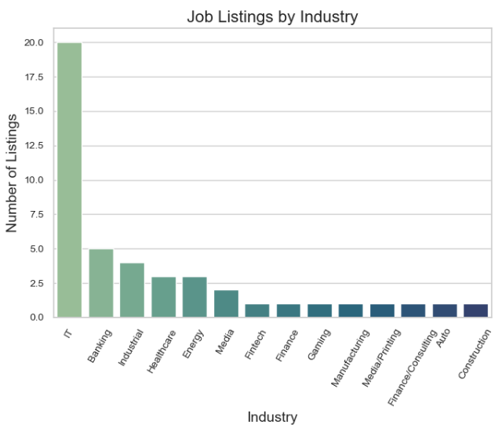
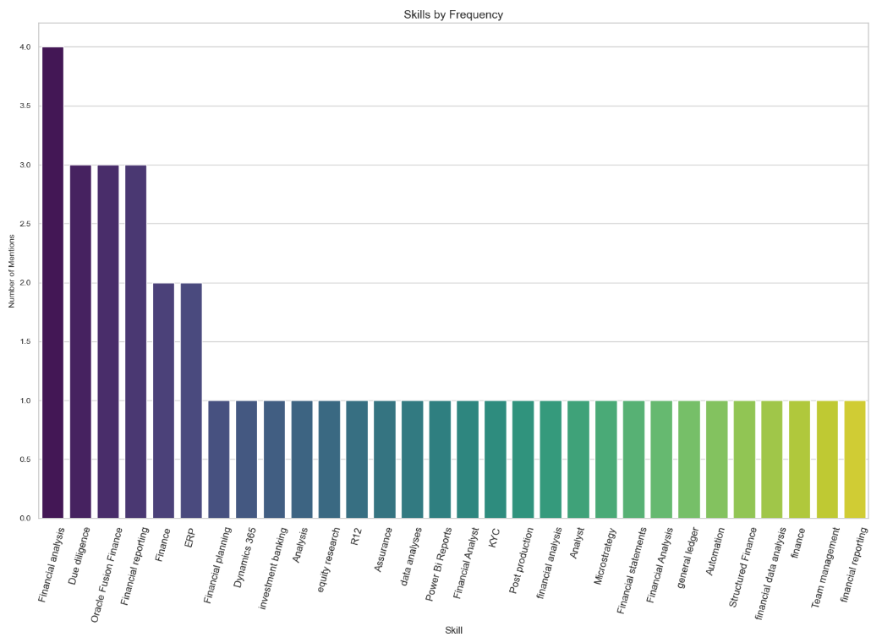

Data visualizations:
The IT industry dominates the job market with nearly 20 listings, far surpassing all other sectors like Banking, Industrial, and Healthcare.
Industries such as Gaming, Auto, and Construction have the least representation, suggesting niche or limited hiring.
Financial analysis is the most frequently mentioned skill, followed closely by Due Diligence and Oracle Fusion Finance.
A wide range of financial and technical skills appear only once, showing a diverse but sparsely required skill set beyond the core competencies.

Slide 18
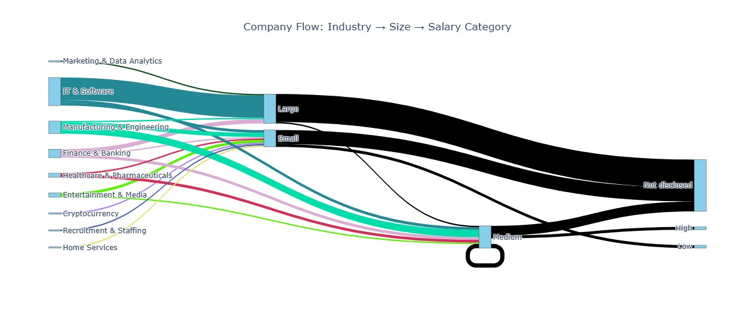
Data visualizations- industry- size- salary:
Here are insights from the Sankey diagram (Industry → Company Size → Salary Category):
The IT & Software industry is the largest contributor to large-sized companies, which in turn dominate the “Not disclosed” salary category.
Small companies are spread across nearly all industries and predominantly link to non-disclosed or low salary categories.
Medium-sized companies exist in various industries but show limited salary disclosure, with only a small flow toward low and high salary categories.
Salary disclosure across all company sizes is heavily lacking, with “Not disclosed” being the most common outcome, reducing salary transparency across sectors.

Slide 19
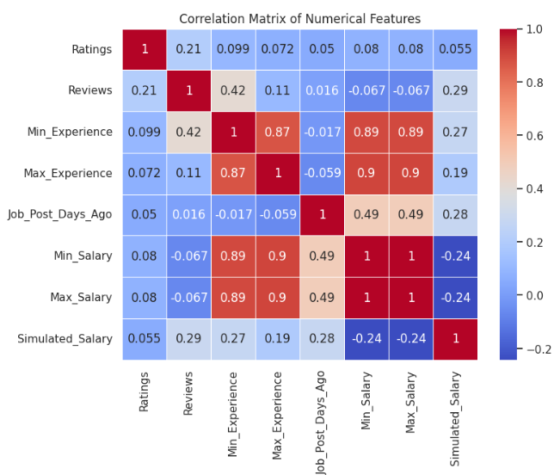
Correlation matrix
Here are key insights from the correlation matrix:
Min_Experience and Max_Experience have a very strong positive correlation (0.87), as expected due to their related nature.
Both Min_Salary and Max_Salary are also strongly correlated (0.9) with experience, indicating that higher experience leads to higher salaries.
Simulated_Salary shows moderate correlation with reviews (0.29) and job post recency (0.28), but negative correlation with actual salaries (-0.24), hinting at differing estimation logic.
Ratings and Job_Post_Days_Ago show weak correlations with most variables, indicating limited influence on experience or salary.

Slide 20
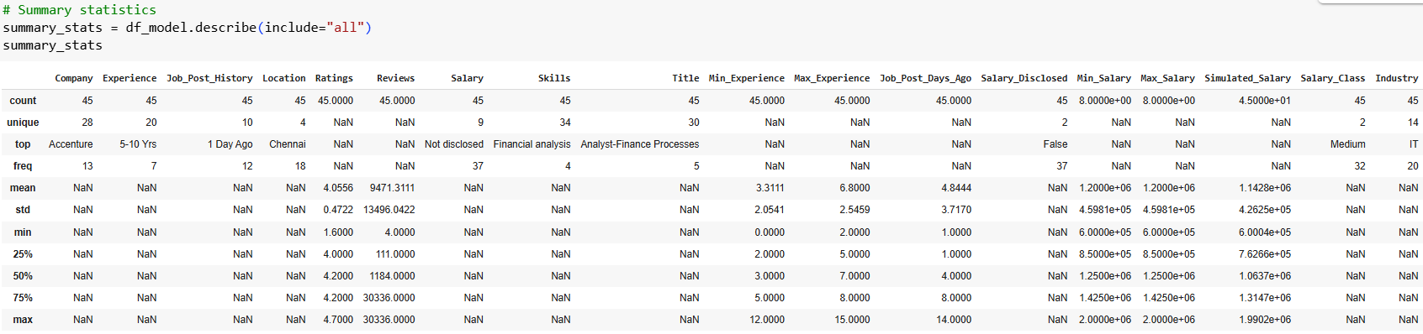
Exploratory data analysis- summary statistics of modified dataset:
Here are 4 key insights from the summary statistics of your dataset:
Accenture dominates the dataset, appearing 13 times out of 45 records, and Chennai is the most common location with 18 entries.
A significant portion of salary data is not disclosed (37 out of 45), yet the salary class “Medium” appears most frequently, indicating class labeling was inferred or imputed.
Ratings range from 1.6 to 4.7 with a mean of 4.05, suggesting generally favorable company reviews.
Min and Max Experience range from 0 to 12 and 2 to 15 years respectively, with Job_Post_Days_Ago having a median of 4 days—indicating most postings are recent.

Slide 21
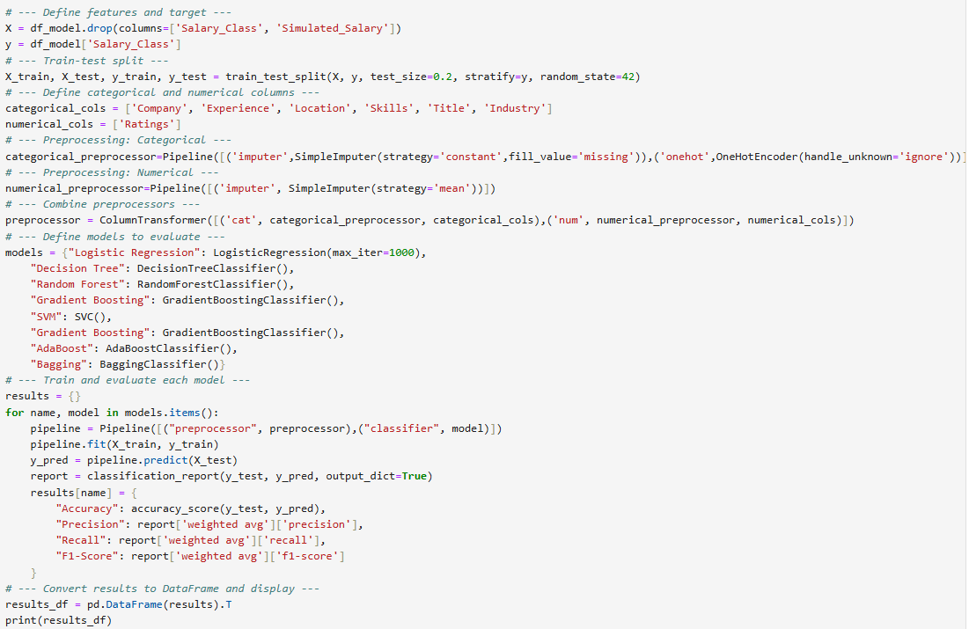
Model building:

Slide 22
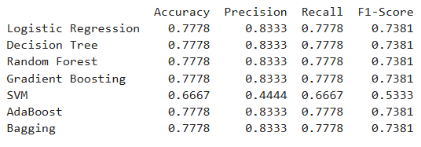
Model building:
This code block performs classification modeling for salary range prediction using multiple algorithms. Here are the key insights:
The models used include:
Traditional classifiers: Logistic Regression, Decision Tree, and SVM
Ensemble models: Random Forest, Gradient Boosting, AdaBoost, and Bagging
Each model is trained within a pipeline, maintaining modularity and cleanliness.
Evaluation metrics captured for each model include Accuracy, Precision, Recall, and F1-Score, calculated using classification report() and stored in a dictionary for display as a Data Frame.
Below are the metrics of the classification models:

Slide 23
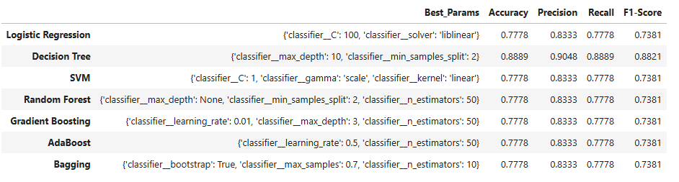
MODEL BUILDING- Application of cross validation & hyperparameter tuning on all the models
Here are key insights from hyperparameter-tuned classification model pipeline:
Seven models (including ensemble methods like Random Forest and Boosting variants) were trained and optimized using GridSearchCV with Stratified 5-Fold CV, ensuring balanced class evaluation.
Each model’s best parameters, along with its accuracy, precision, recall, and F1-score, were captured on the test set to assess real-world generalization.
The final Data Frame comprehensive comparison, enabling easy selection of the best-performing model based on weighted F1-score.

Slide 24
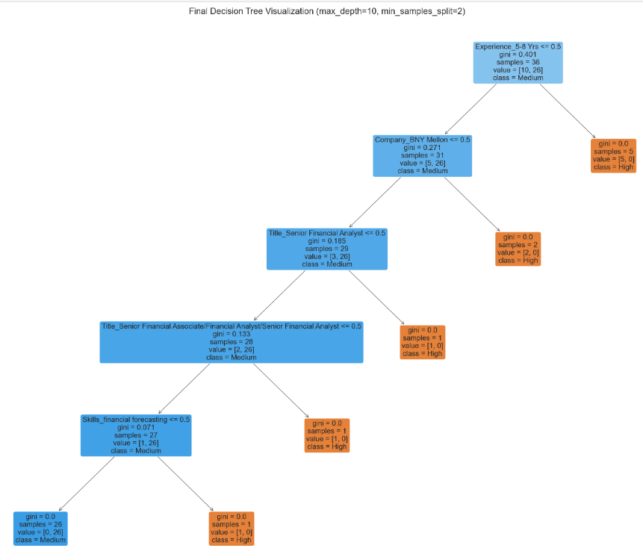
Model building- consideration of best model:
Decision Tree outperforms all other models with the highest accuracy (0.8889) and F1-score (0.8821), making it the most effective classifier for salary range prediction. The best-performing Decision Tree used max_depth=10 and min_samples_split=2, indicating the model benefits from deeper splits.
All other models, including Logistic Regression, SVM, and ensemble methods like Random Forest and Gradient Boosting, have identical performance metrics (Accuracy: 0.7778, F1-Score: 0.7381).Despite tuning, ensemble models like Random Forest and AdaBoost did not surpass a basic Decision Tree, suggesting that the dataset may favor simpler tree-based logic.
Below is the decision tree structure:

Slide 25
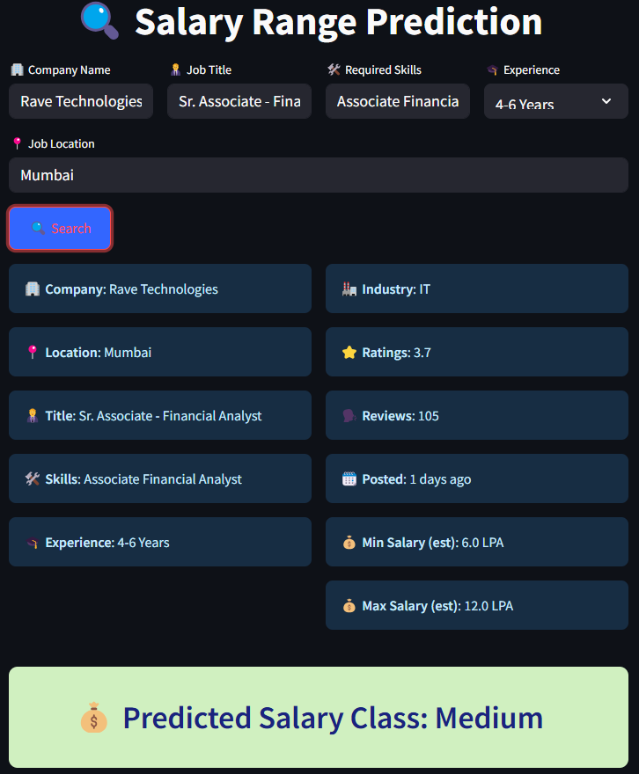
deployment

Slide 26
DEPLOYMENT:
Here are 4 insights from the Streamlit-based Salary Range Prediction app interface:
The UI allows users to input company name, job title, skills, experience, and location to get a predicted salary range.
Based on the input for Rave Technologies in Mumbai, the model predicts a "Medium" salary class, with an estimated range of 6.0 – 12.0 LPA.
Additional job metadata such as ratings (3.7), number of reviews (105), and posting recency (1 day ago) is clearly displayed, enhancing user context.
The interface is intuitive, visually appealing, and well-organized, making it suitable for non-technical users to explore salary insights effectively.

Slide 27
Thank you
By
L.SUCHARITA
B.UDAY KUMAR
CH.PRAVALIKA
K.SHYAM KUMAR
A.RISHIKA

